Slide 1
Maximum Likelihood Estimation
for
SDEs with Multiplicative Noise
Speaker: Xiaoqian Chen
Adviser: Timofeyev Ilya
Nov, 2018

Slide 2
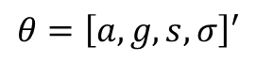
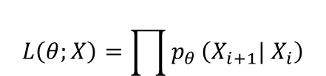
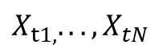
Consider
Where
a , g > 0（for stationary);
W1 and w2 are independent Wiener process;
GOAL:
$${dX}_{t}=−aX_{t}^{3}dt−gX_{t}dt+sdW1+σX_{t}dW2$$
Discrete observations:
{ }
Maximum Likelihood
Estimate
Parameter vector:
$$X_{t1,}...,X_{tN}$$
$$θ=\left[a,g,s,σ\right]′$$
$$X_{1},...,X_{n}$$
$$L\left(θ;X\right)=\prod{p_{θ}}\left(X_{i+1}| X_{i}\right)$$

Slide 3
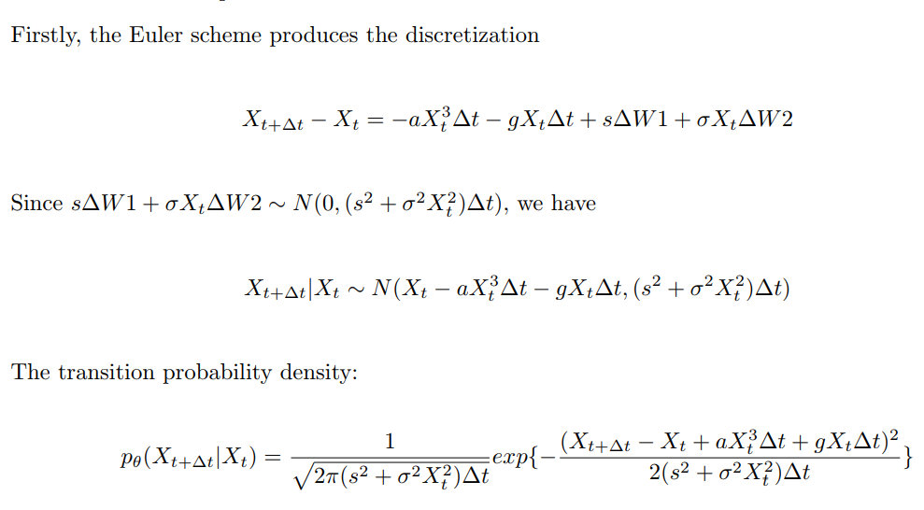
~N(0,∆t)
~N(0,∆t)

Slide 4
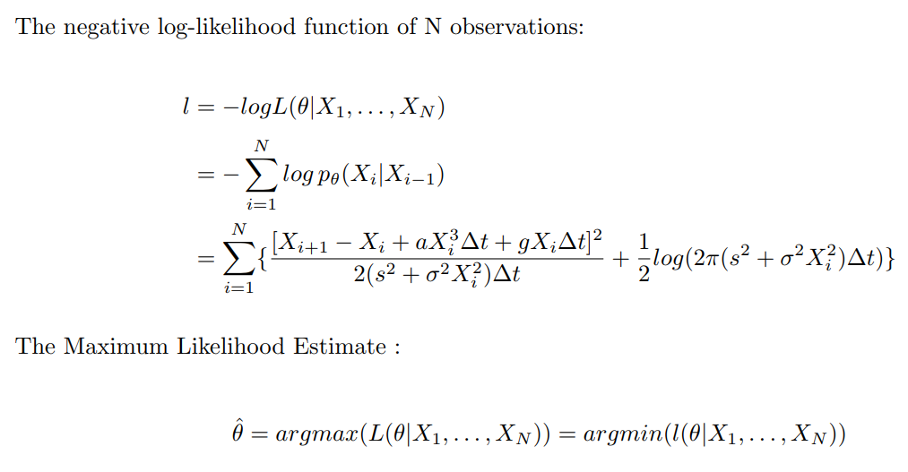

Slide 5
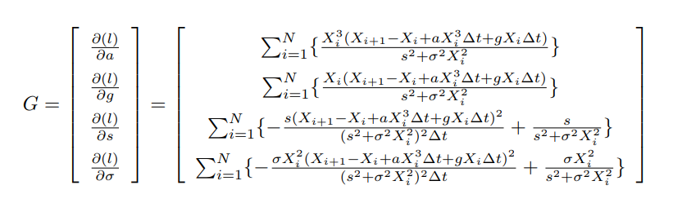

No analytical solution ?
Numerical global optimization !

Slide 6
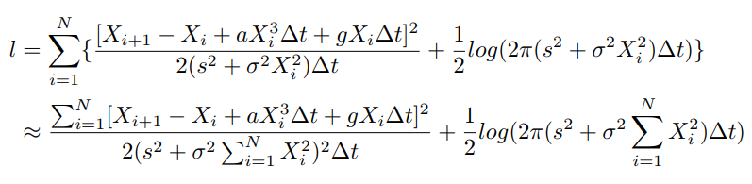
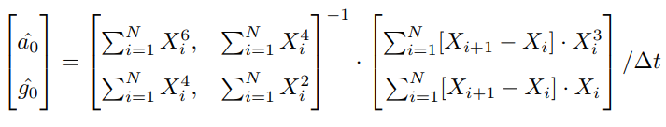
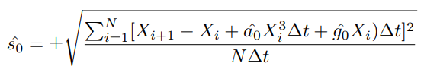
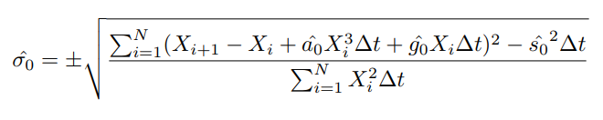
Initial Guess

Slide 7
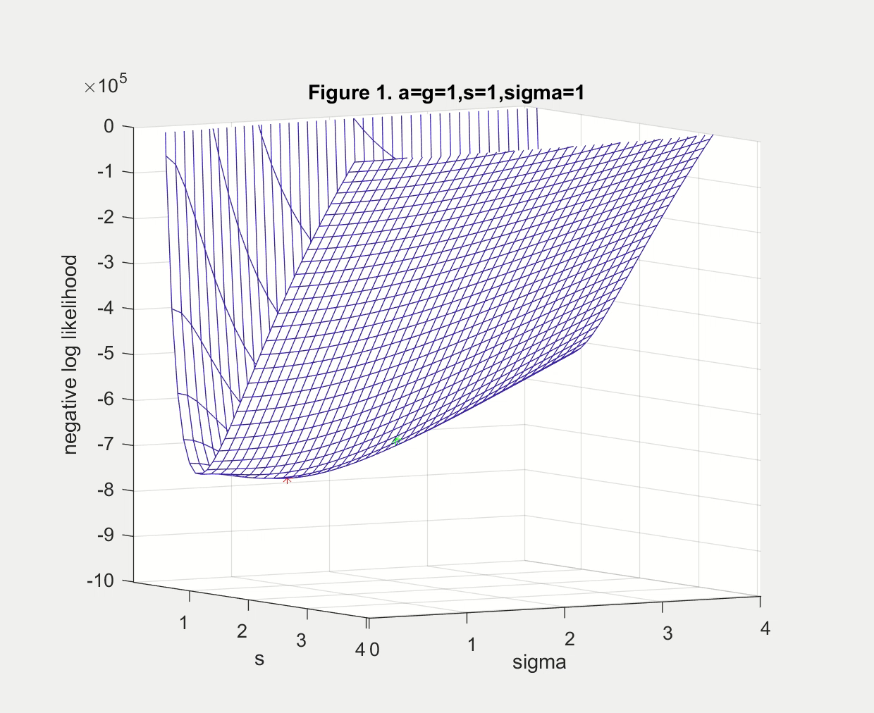
MLE:
a=0.9890
g=1.0414
s=1.0034
σ=0.9962
Initial Guess:
a=1.0038
g=1.0255
s=1.1503
σ=2.0377

Slide 8
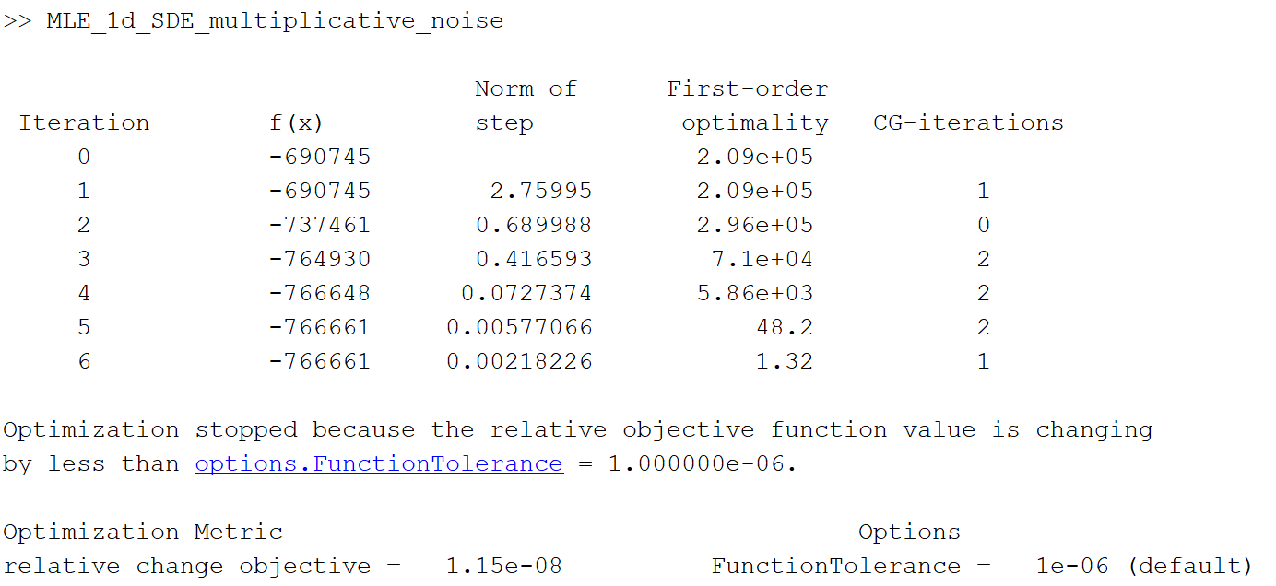

Slide 9
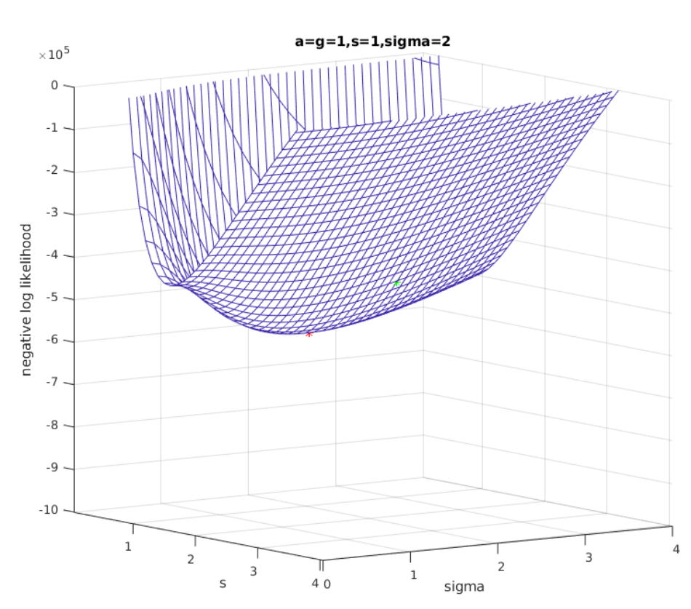
MLE:
a=0.9767
g=0.9944
s=1.004
σ=2.0167
Initial Guess:
a=0.9630
g=1.0886
s=1.5880
σ=2.5910

Slide 10
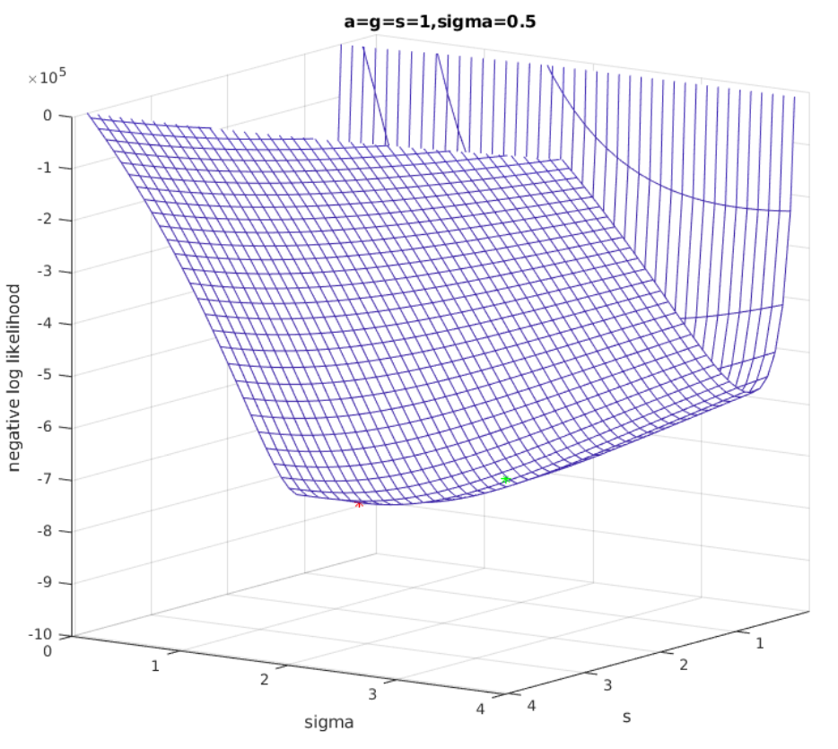
MLE:
a=0.9862
g=1.0211
s=0.9993
σ=-0.5009
Initial Guess:
a=0.9828
g=1.0243
s=1.0361
σ=1.8981

Slide 11
